Slide 1
MetaPhyler and Ensemble Building for Metagenomic Classifiers
Prepared By: Moon Kim and Nick Falkowski

Slide 2
MetaPhyler Summary
Taxonomic classifier for metagenomic DNA or protein sequences
Based on BLAST
Dynamic classifier parameters (learned from reference database)
Can train itself when given a set of reference sequences/taxa labels
Default database comes pre-trained on 31 phylogenetic marker genes
All complete genomes
Several draft genomes
NCBI ‘nr’ database

Slide 3
MetaPhyler Advantages
Can identify individual bacterial genomes and proteins with:
Different evolutionary rates
Metagenomic read gene fragments of different lengths
Tunes the taxonomic classifier based on:
Length of each HSP (high scoring segment pairs in BLAST)
Reference gene
Taxonomic level
Has the ability to identify novel organisms or taxa
Demonstrated to outperform similar tools (CARMA, Megan, and PhymmBL)
Faster because of BLAST approach vs phylogenetic trees and the reference database is much smaller then NCBI ‘nr’

Slide 4
MetaPhyler Pipeline

Slide 5
MetaPhyler Installation
Requirements: g++; Perl; NCBI BLAST; *(and Blast+)
Download latest version from http://metaphyler.cbcb.umd.edu/
Un-compress the package: tar xzvf package-name
Run the setup script: ./installMetaphyler.pl

Slide 6
MetaPhyler Usage
Use the pre-trained phylogenetic marker database
Convert all reads to FASTA format
./runMetaphyler.pl executes the entire pipeline
Short reads (average 100bp, e.g. Illumina) use blastn
Long reads (e.g., 454 or Sanger) blastx is recommended
Best performance if both blastn and blastx results are combined

Slide 7
MetaPhyler Tips
Old version of BLAST is used in MetaPhyler scripts
Use formatdb to compile reference database (old blast)
Modify run scripts to use BLAST+ for substantial speed up
Other versions of BLAST cannot be used if are you unable to set output format, for example mpiBLAST

Slide 8
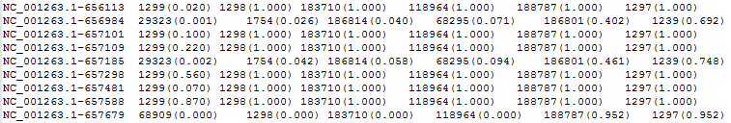
MetaPhyler Classification Output
Contains taxa ids found with confidence scores

Slide 9
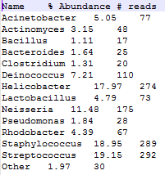
MetaPhyler Tax Profile Output
Taxonomy profiles are output to files split by tax level such as “ds.gut.blastn.genus.taxprof”
Output contains the tax name, abundance, and # reads

Slide 10

MetaPhyler Algorithom (Building Classifier)
Simulate 60bp metagenomic reads from all reference marker genes
Map simulated reads against reference gene using BLASTX
Store BLASTX bit scores between gene and the simulated reads that are from the same order and find bit score cutoff that minimizes: $\sum_{b_{i}∈B_{order}}{I(b_{i}<b_{cut})}+\sum_{b_{j}∈B_{else}}{I(b_{j}>b_{cut})}$
Repeat for simulated reads of lengths 120bp, 180bp, up to the length of the gene in 60bp increments
Linear regression function to find cutoffs for arbitrary matching lengths: $b_{cut}^{L}=a+bL$ (where L is sequence length, $b_{cut}^{L}$ is the bit cutoff score, and ‘a’ and ‘b’ are parameter estimates from the data
Repeat for all taxonomic levels

Slide 11
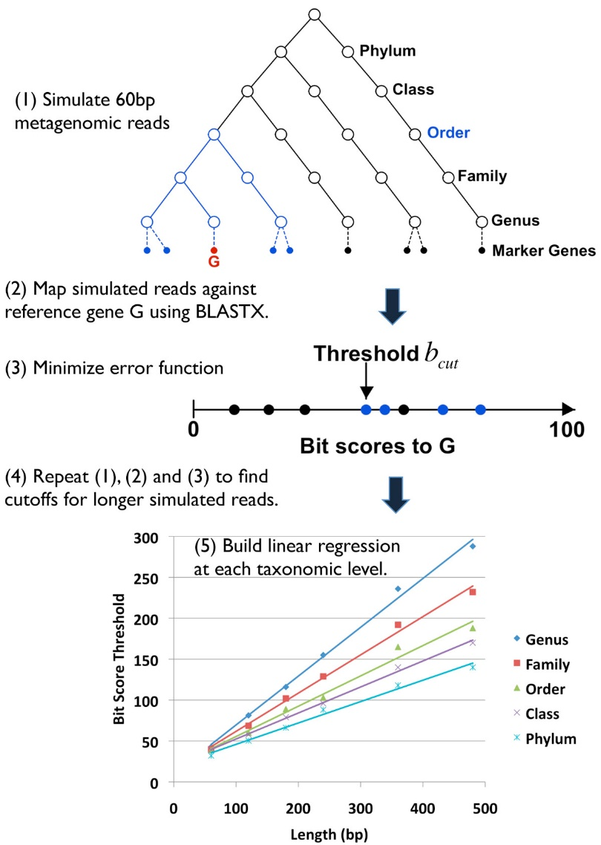
MetaPhyler Algorithom (Building Classifier)

Slide 12
MetaPhyler Algorithom (Classifying)
Classifies each sequence individually based on its best reference hit.
Classify query sequence at the genus level by calculating the bit score cutoff of gene using the pre-computed linear regression function
If the bit score is higher than the cutoff, transfer the genus label of reference gene to query sequence
Otherwise, try to classify query sequence at higher taxonomic levels (family, order, class and phylum) using level-specific classifiers built for the gene

Slide 13
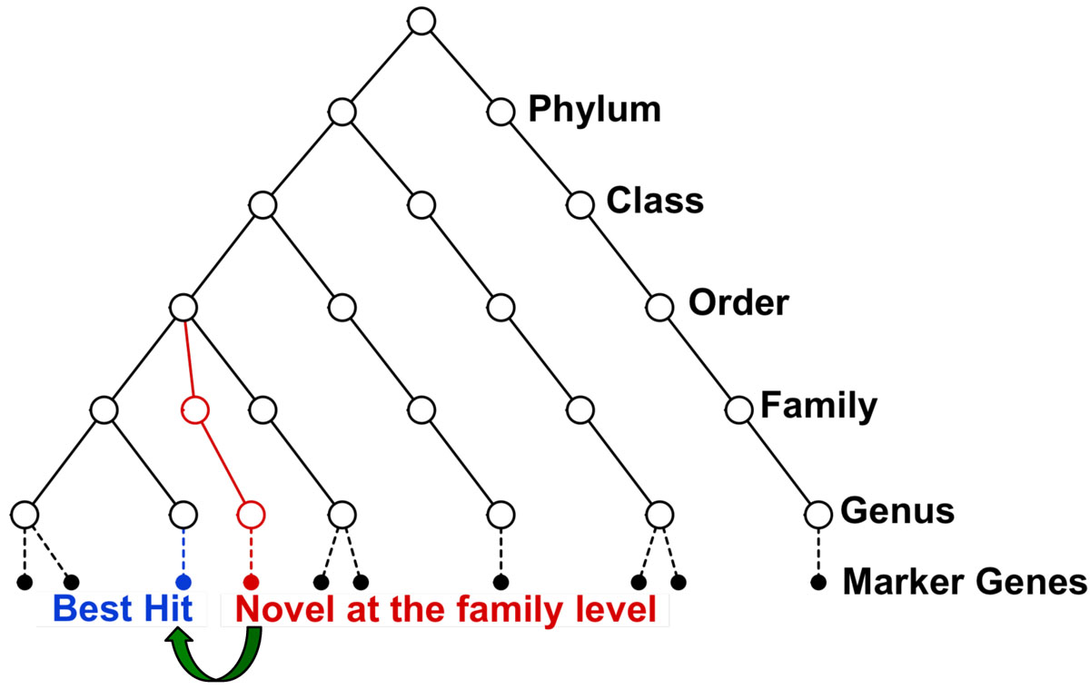
MetaPhyler Algorithom (Classifying)

Slide 14
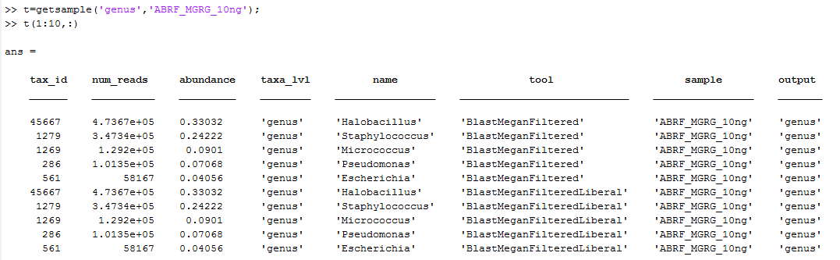
Ensemble Building
OTU Tables from each of the data sets across each tool were provided. Information provided in the OTU tables were standardized, where taxonomic information, relative abundance, and raw reads were listed.
MATLAB scripts were written to compile the hundreds of OTU tables into a table data structure within MATLAB for ease of manipulation.

Slide 15
Tool Ranking Methodology
Ranked tools on a false positive metric
False Positives were considered as those taxa which showed up in the tools OTU table which were not in the Truth table
Total number of false positives were counted across an entire taxonomic level (for all dataset) across each tool.
Raw count method seemed biased against certain tools

Slide 16
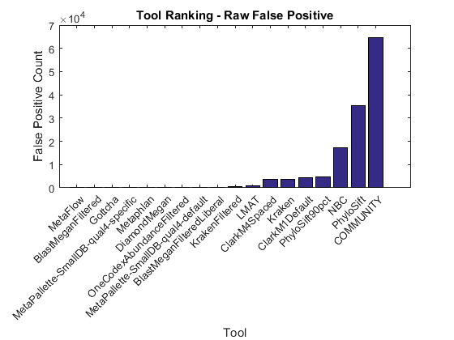
Tool Ranking Methodology

Slide 17
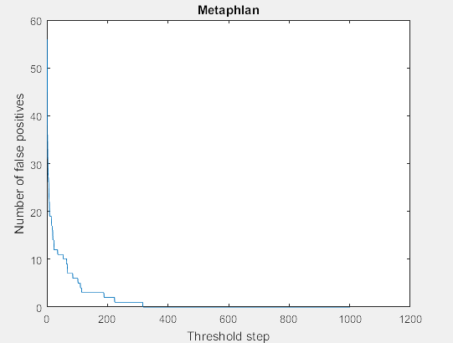
Tool Ranking Methodology
A threshold was set at the false positive’s relative abundance.
Simulated across 1000 steps
Found relative abundance above 0.95% to be a good threshold level
False positives below threshold were counted as a tenth of a False positive

Slide 18
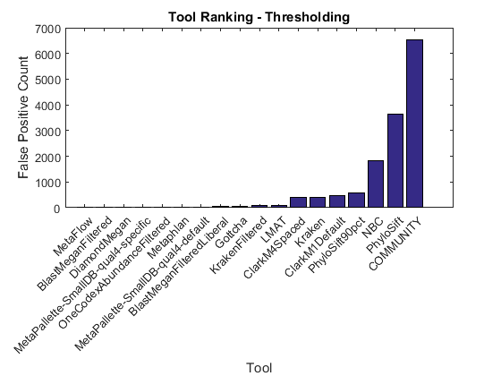
Tool Ranking Methodology

Slide 19

Tool Ranking Methodology
Threshold method also seemed biased towards tools which under reported taxa in a given sample.
Wanted to reward classifiers for having the correct output
Used Precision metric: $\frac{tp}{tp+fn}$
True positives were those taxa that were in the tools OTU table and Truth table.
Used False negative from previous method

Slide 20
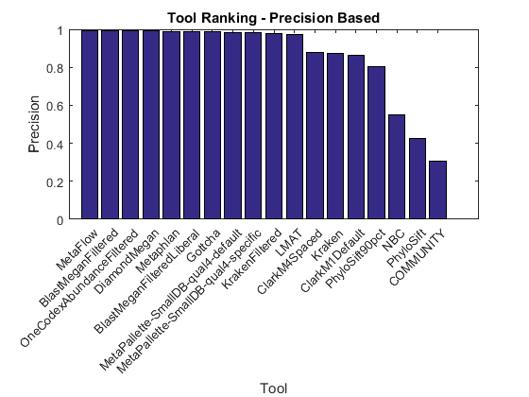
Tool Ranking Methodology

Slide 21
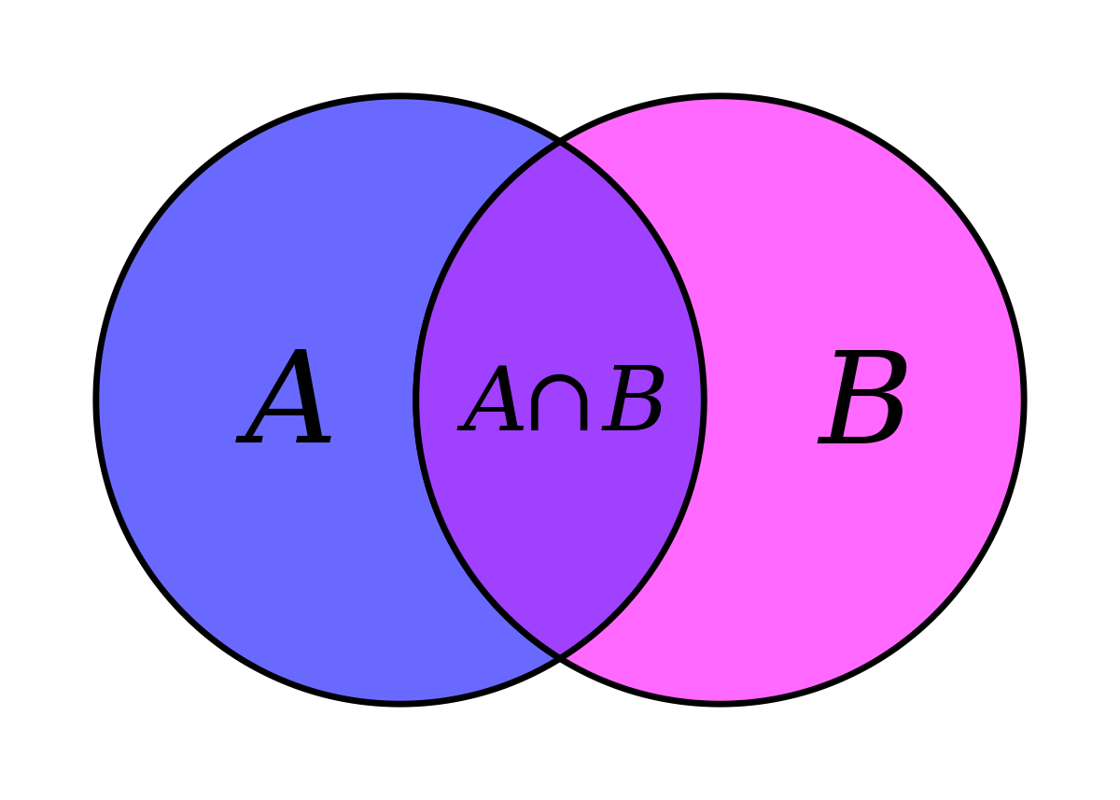
Ensemble of Classifiers
Combination of classifiers to improve performance over an individual classifier
Tools were intersected to build the ensemble

Slide 22
Intersection of Top N Classifiers
All agreements between the top ranking classifiers was considered the output.
Great at removing false positives.
Poor performance, as many of the taxa found in the truth were no longer found at the output of the classifier.

Slide 23
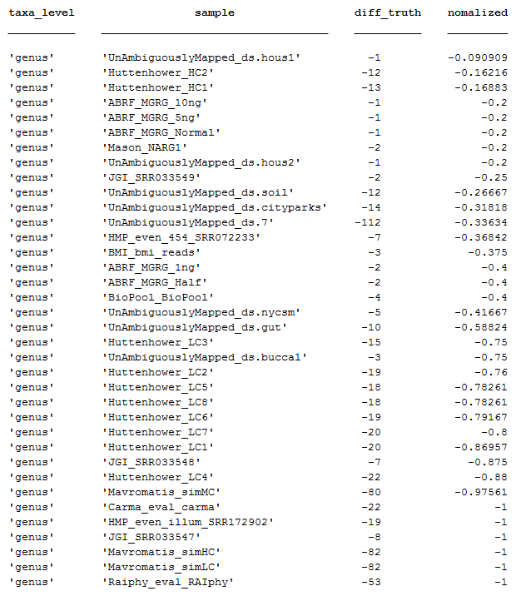
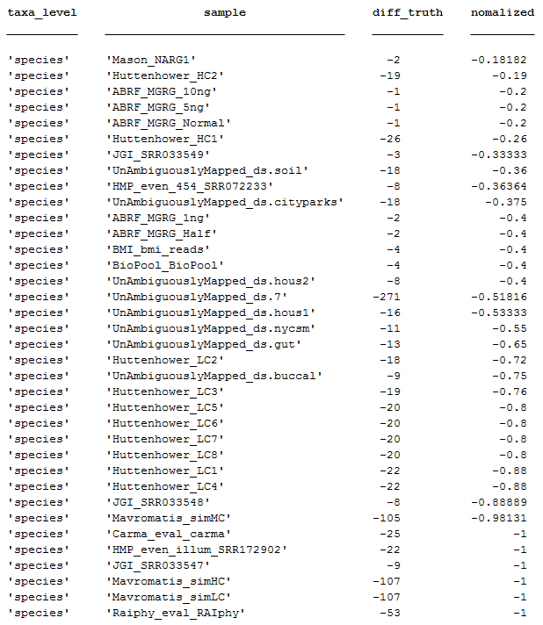
Intersection of Top 3 Classifiers

Slide 24

Majority Voting
Top 5 classifiers considered
Agreements of 3 or greater were considered the output

Slide 25
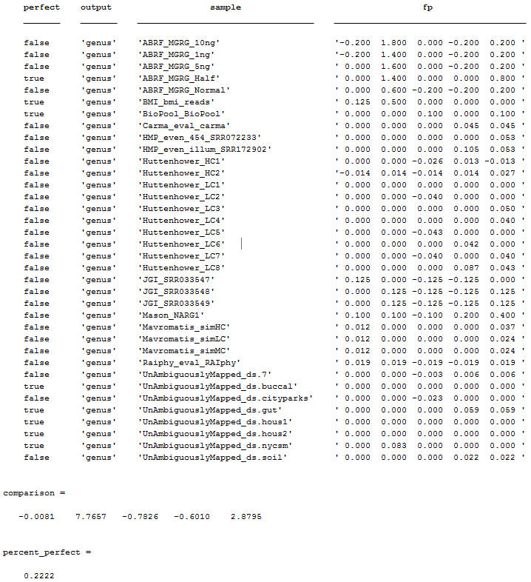
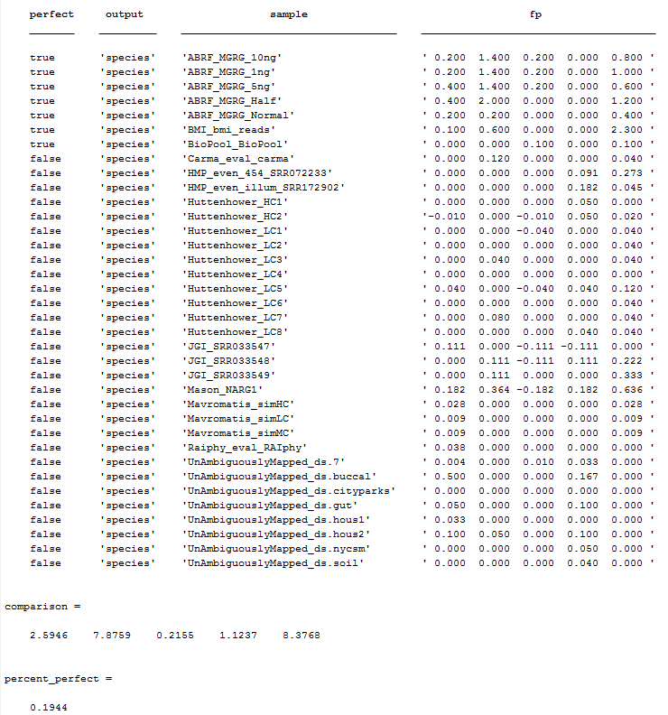
Majority Voting

Slide 26
Weighted Majority Voting
Original rankings considered
Top ranking tool has 5x the influence of the 5th ranking tool.
Weights decrease linearly
Scores greater than 8 were considered the output

Slide 27
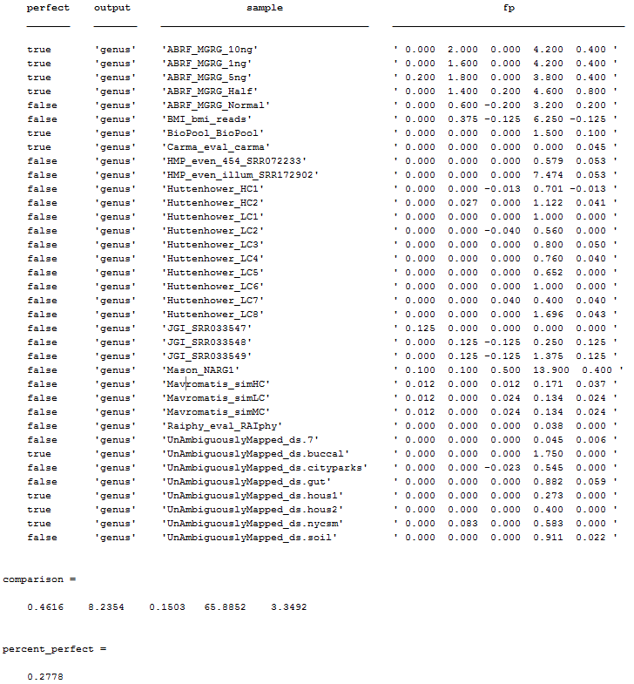

Weighted Majority Voting

Slide 28
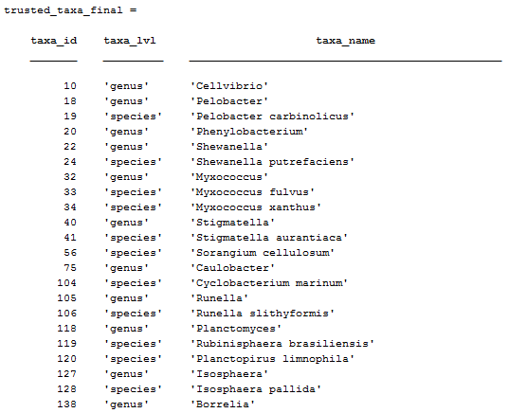
Trusted Taxa IDs
Found 1051 trustworthy taxa IDs across the genus and species level

Slide 29
Github Repository
https://github.com/t680metaphylerbenchmark/T680_Benchmark_Ensemble_Project

